Slide 1

Notes:
- The honorable examiners of this final assignment examination, Good Afternoon Mr Bana Handaga, Mr Junaidi
- In This Special occasion, I'm ... a student of
- I would like to thank to the examiners who have given me an opportunity to present about my thesis with the title

Slide 2


Slide 3
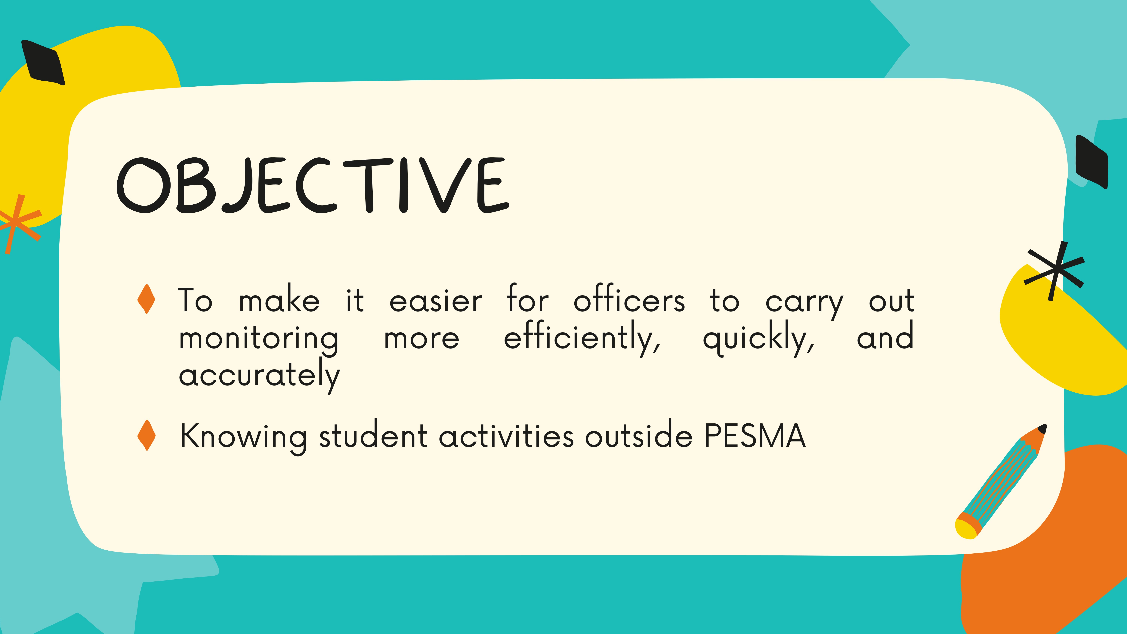

Slide 4
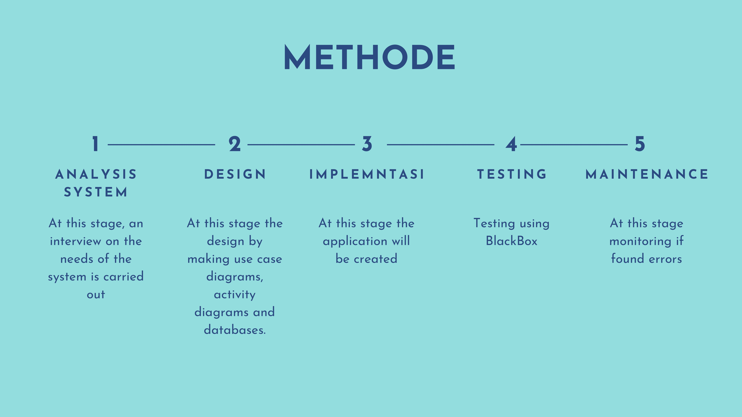

Slide 5
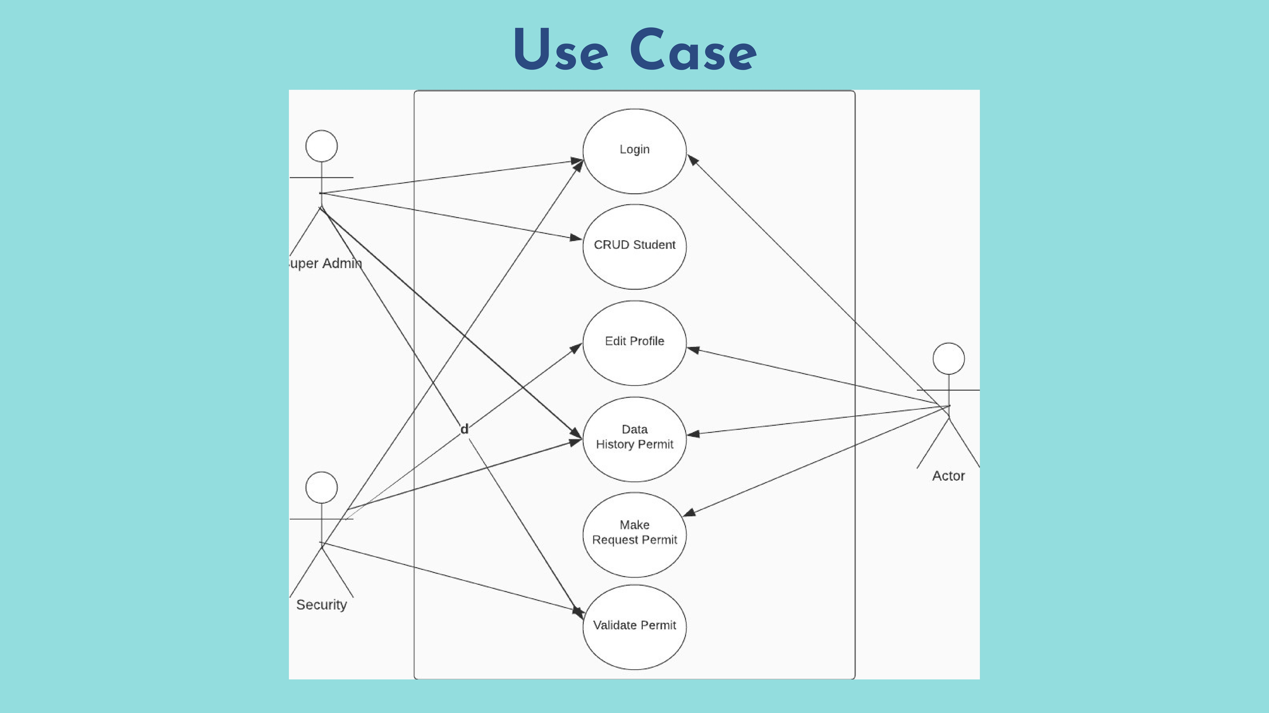

Slide 6
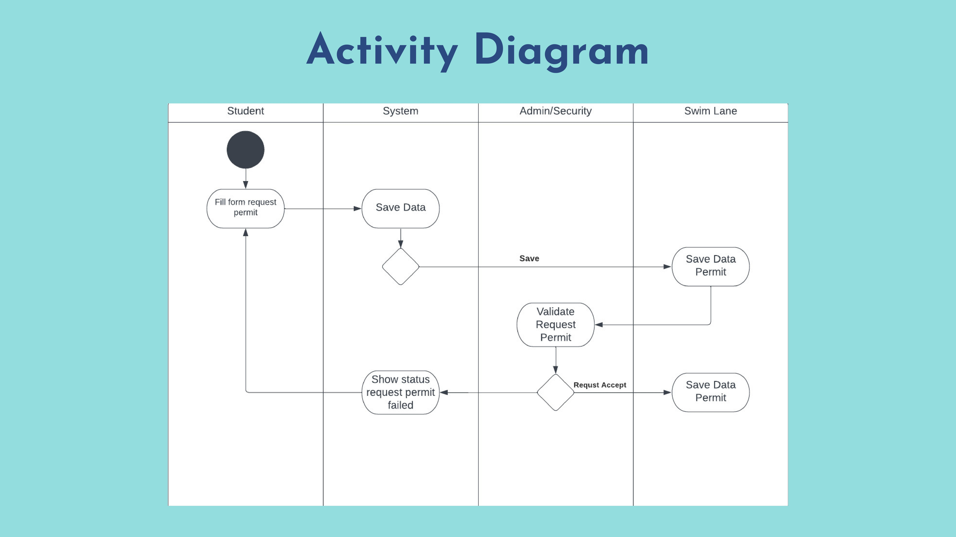

Slide 7
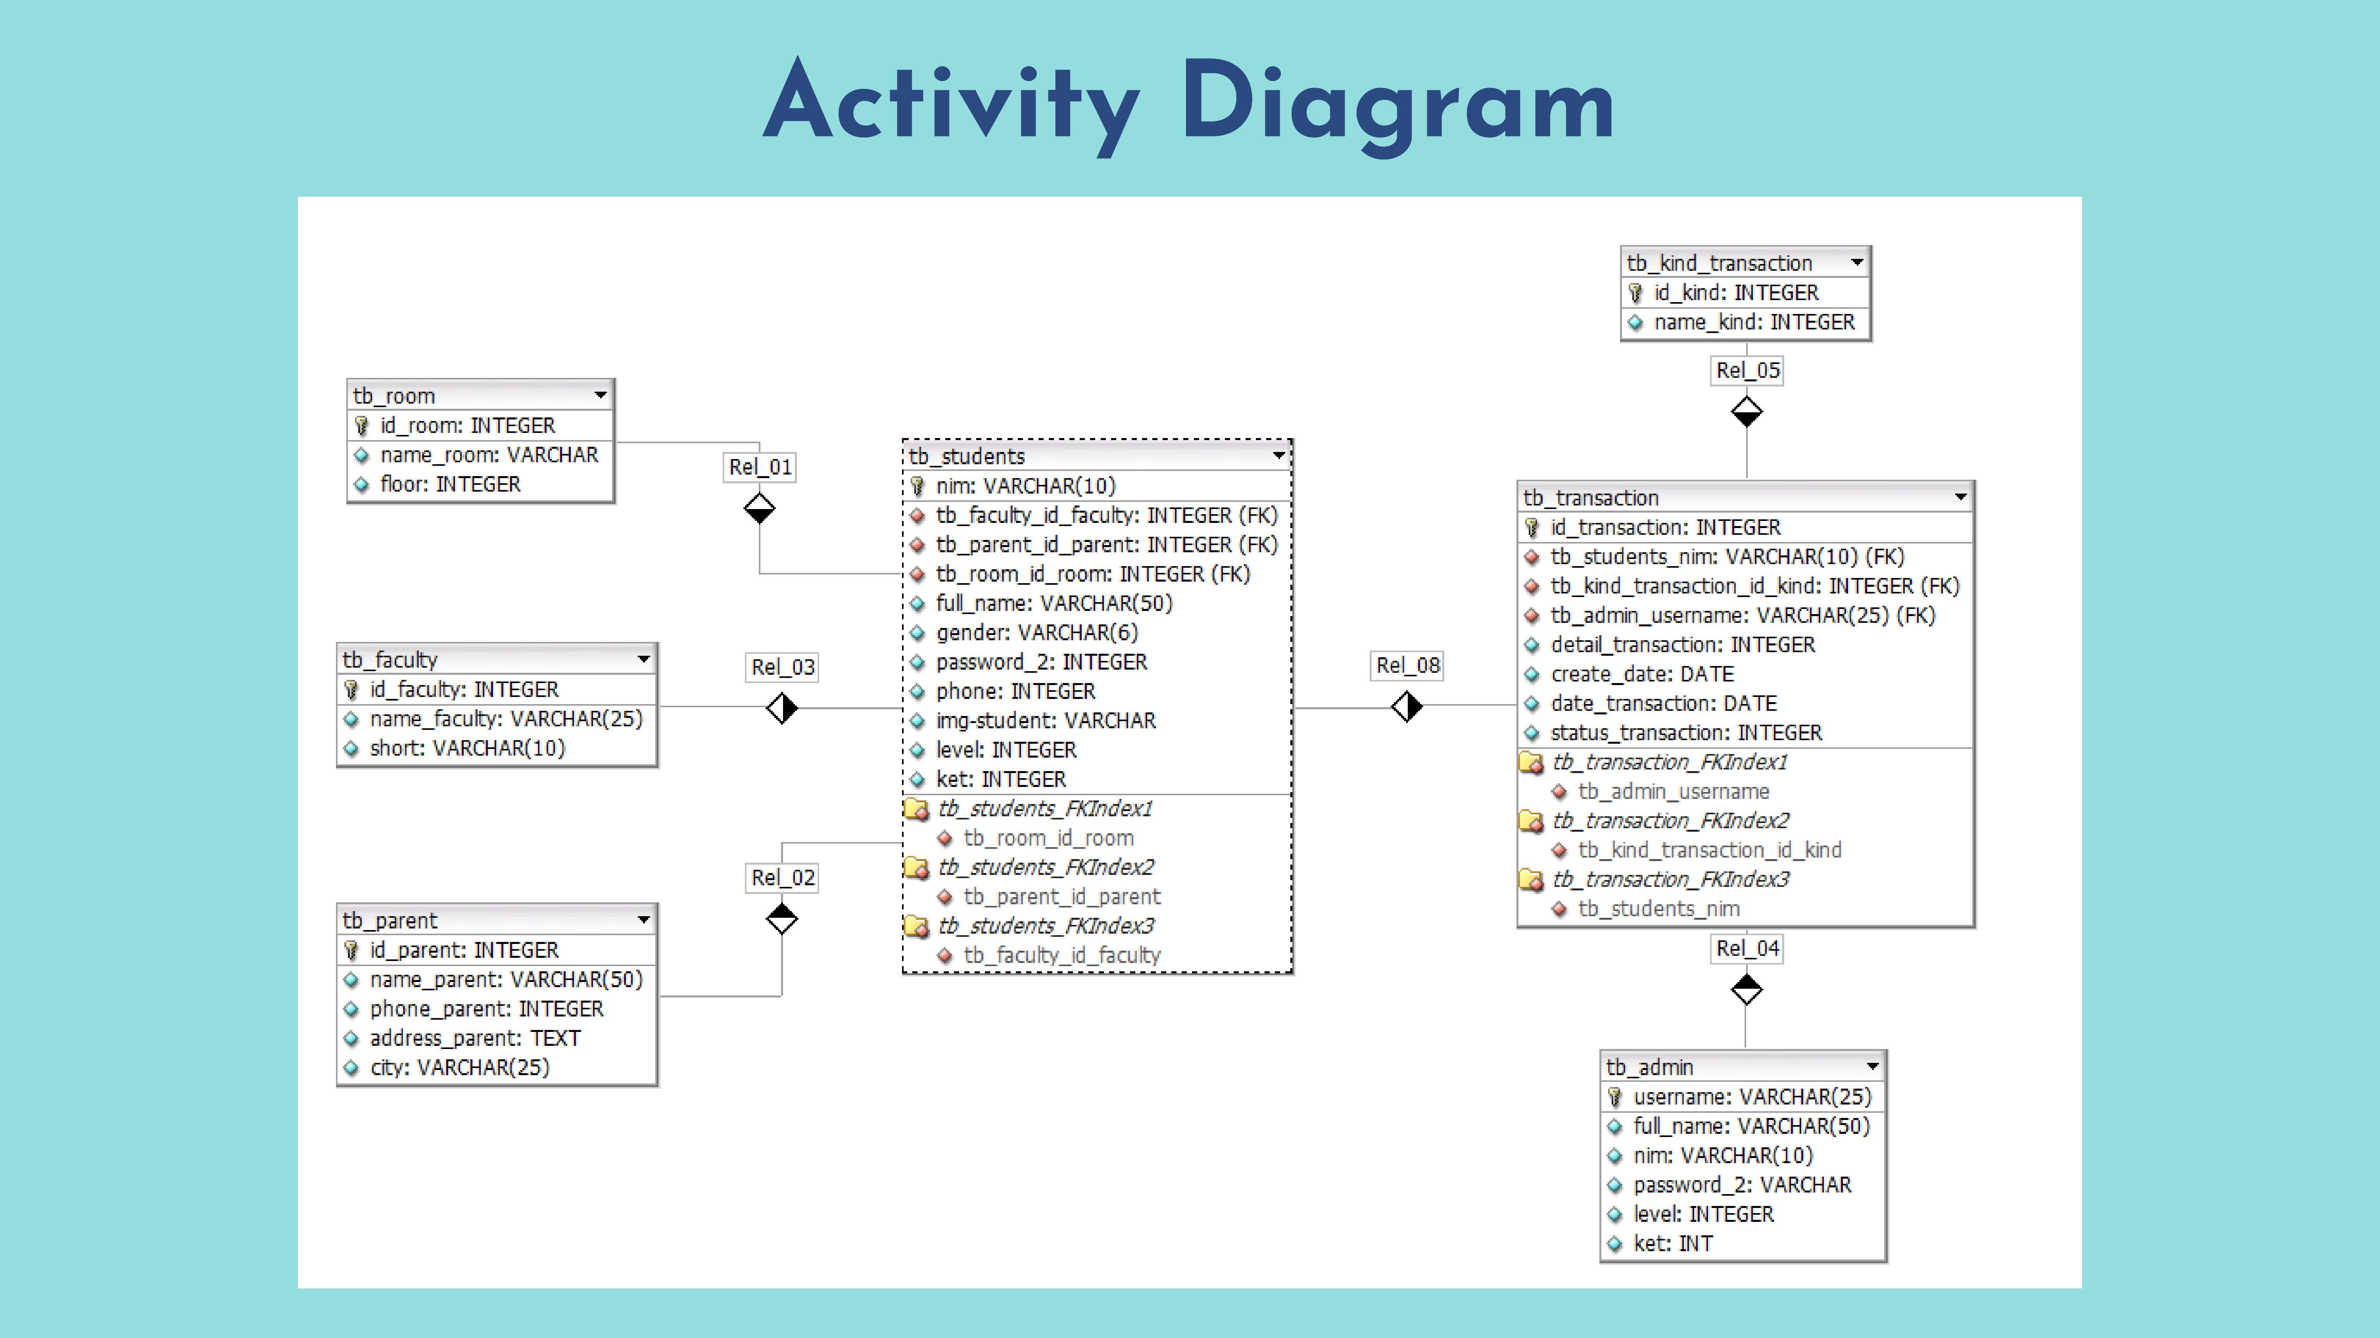

Slide 8
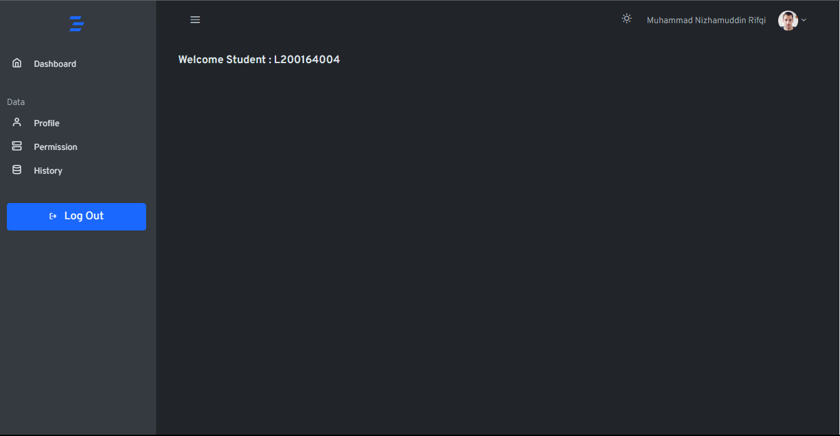
Dashboard Student

Slide 9
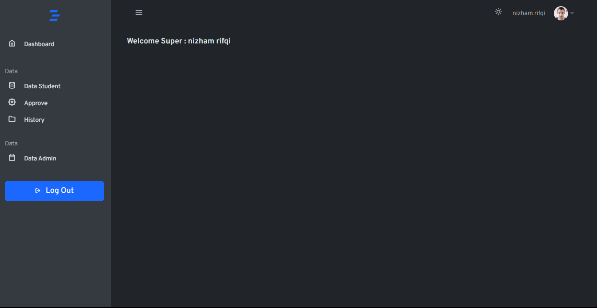
Dashboard Super

Slide 10
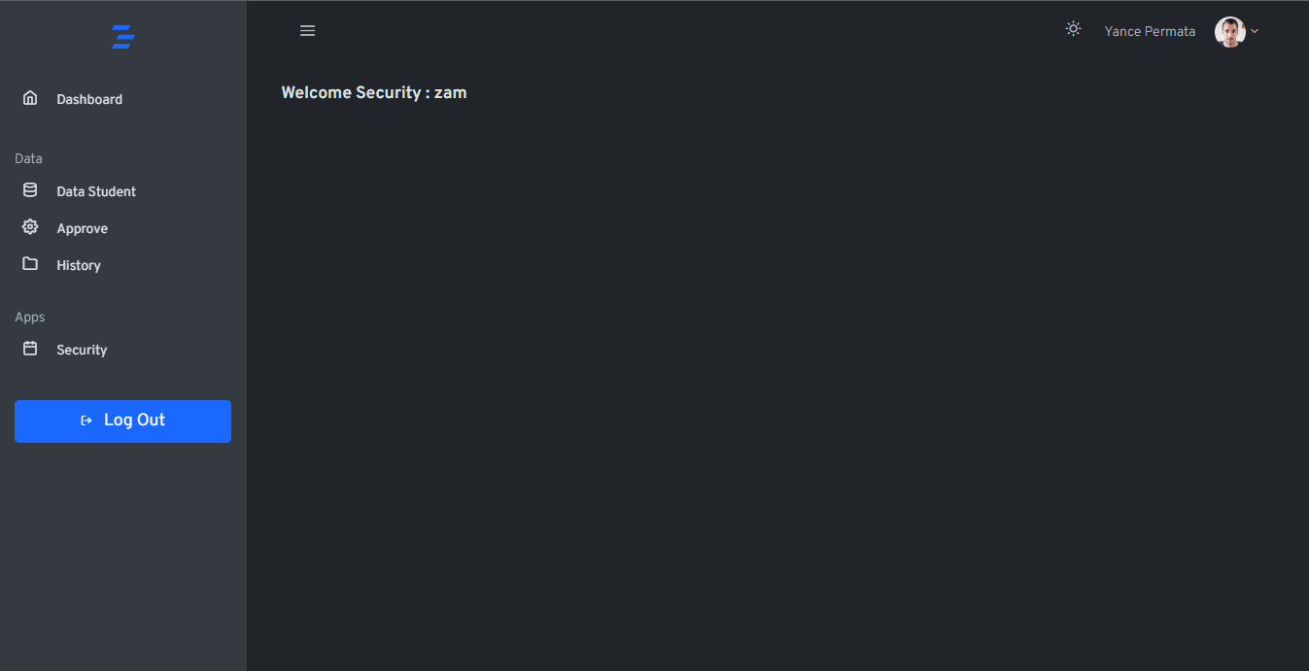
Dashboard Security

Slide 11
CONCLUSION
Based on blackbox functional system can run well and the system makes a positive impact on the pesma

Slide 12
DEMO

Slide 13
THANK YOU
Notes:
That’s all for our presentation today and thank you so much for your attention

